Slide 1

Quiz Management
Project
Submitted By Durgesh Dhyani
Guided By Pavitra Mam

Slide 2
Introduction
The project: “Quiz Management Application” is a collection of number of different types of quizzes like technical, games, sports, etc. A user can access/play all of the quiz and can attempt any of the one. There will be limited number of questions and for each correct answer user will get a credit score.

Slide 3
Applications
Benefits for students
Get instant results
Support self-learning
Revise knowledge
Raise confidence
Prepare for exams

Slide 4
Application
Quiz benefits for teachers
A useful assessment tool
Open doors for experiments
Save time and effort
Anytime, anywhere assessment
Track learning and teaching performance

Slide 5
Modules
Normal User(Student)
Admin (Teacher)
Category
Quiz
Question

Slide 6
SOFTWARE REQUIREMENTS
Backend:
Spring Core
Spring Boot
Rest API
Java Persistence API Data
Postman
Database:
MySQL

Slide 7
SOFTWARE REQUIREMENTS
Frontend
Angular
Browser(Chrome)

Slide 8
ER-DIAGRAM

Slide 9
WHAT IS SPRING BOOT?
Java Spring Boot(Spring Boot) is a tool that makes developing web application and micro-services with Spring Framework faster and easier through three core capabilities
Auto Configuration
An Opinionated approach to Configuration
The ability to create standalone applications

Slide 10
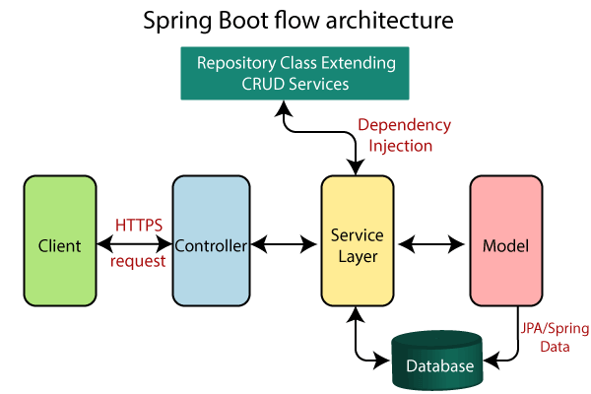
Architecture

Slide 11
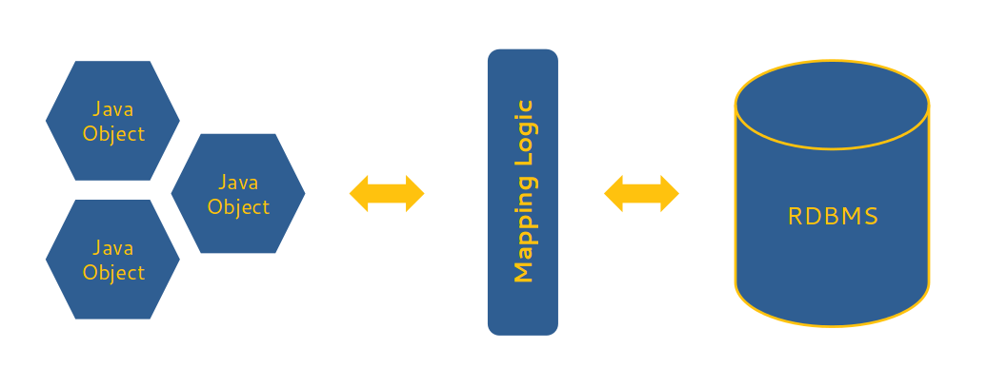
Java Persistence API
A JPA (Java Persistence API) is a specification of Java which is used to access, manage, and persist data between Java object and relational database.
It is considered as a standard approach for Object Relational Mapping.
JPA can be seen as a bridge between object-oriented domain models and relational database systems.

Slide 12
POSTMAN
Postman is an application used for API testing.
It is an HTTP client that tests HTTP requests, utilizing a graphical user interface, through which we obtain different types of responses that need to be subsequently validated.
Postman is an application that allows us to test APIs utilizing a graphical user interface.

Slide 13
JWT Security
JSON Web Token (JWT) is an open standard (RFC 7519) that defines a compact and self-contained way for securely transmitting information between parties as a JSON object. This information can be verified and trusted because it is digitally signed. JWTs can be signed using a secret (with the HMAC algorithm) or a public/private key pair using RSA or ECDSA.

Slide 14
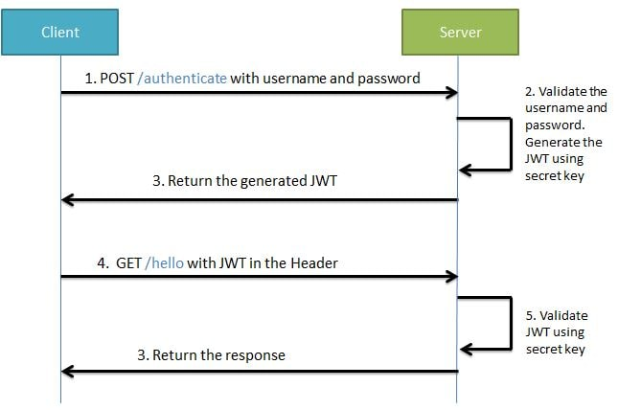
JWT Working

Slide 15
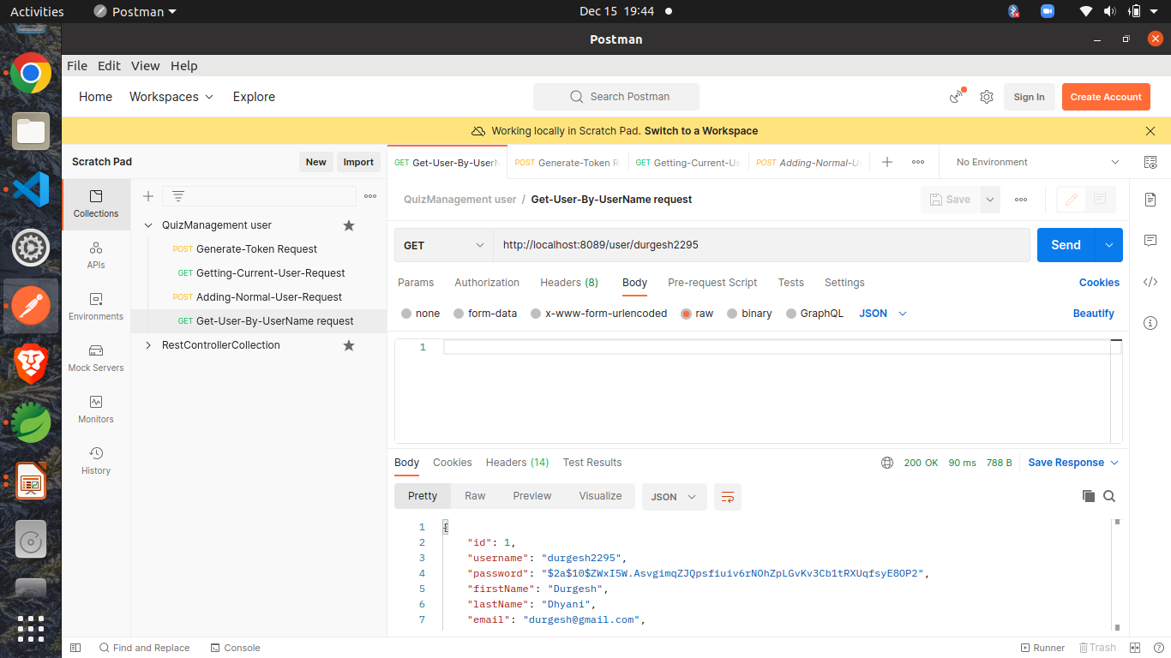

Slide 16
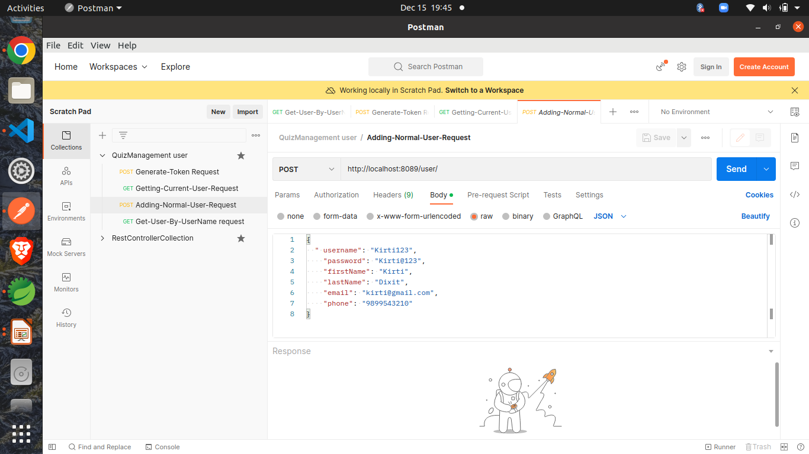

Slide 17
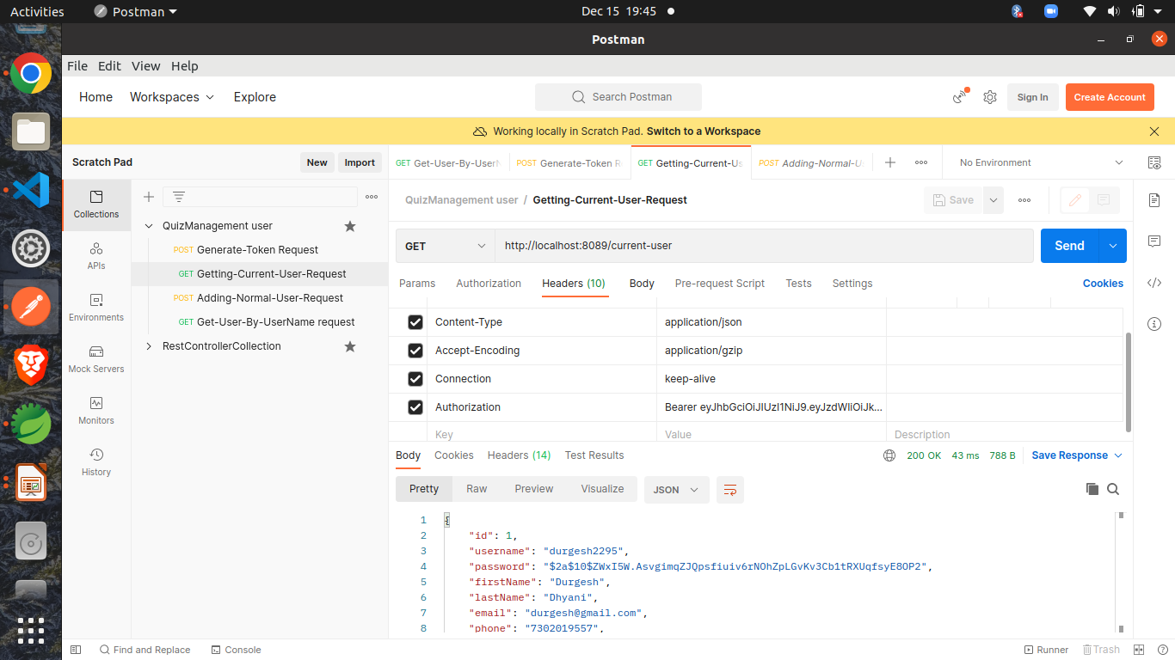

Slide 18
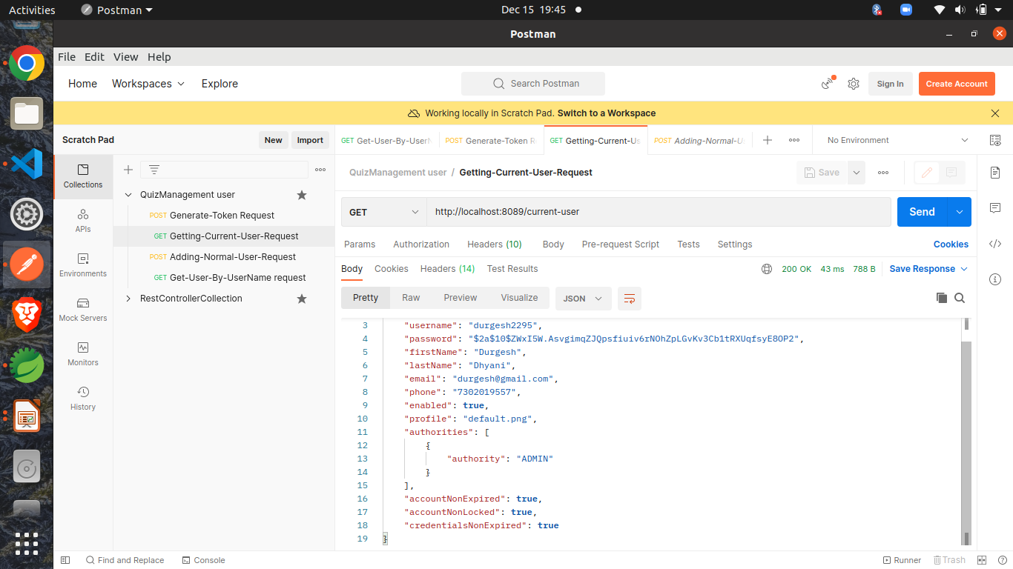

Slide 19
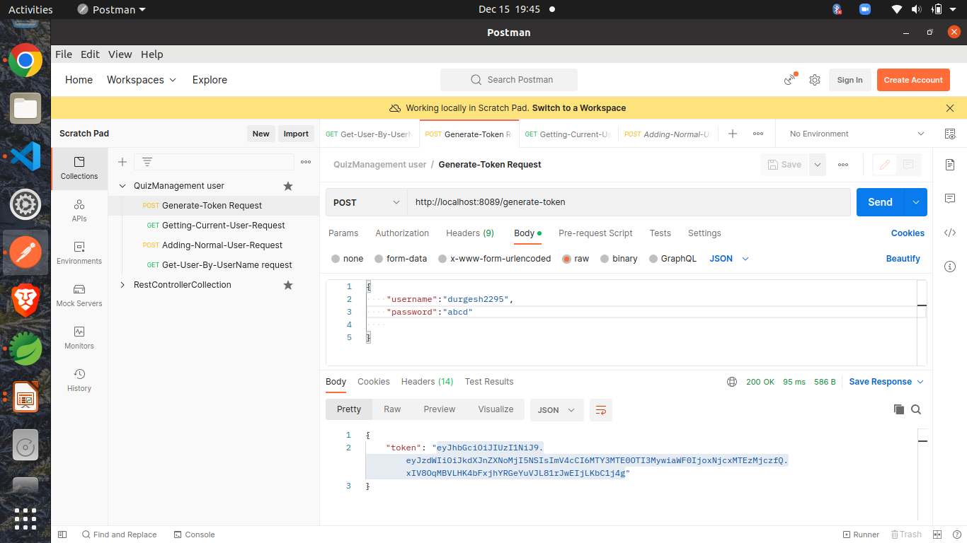

Slide 20
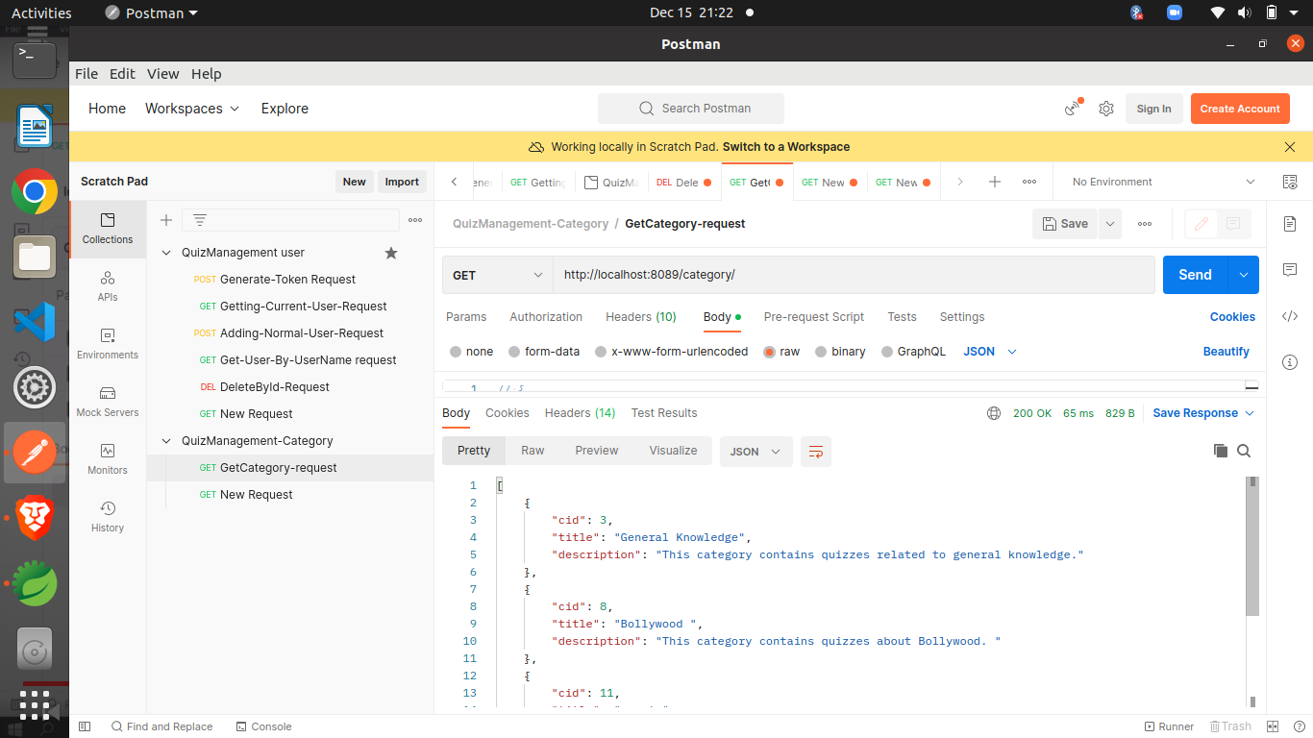

Slide 21
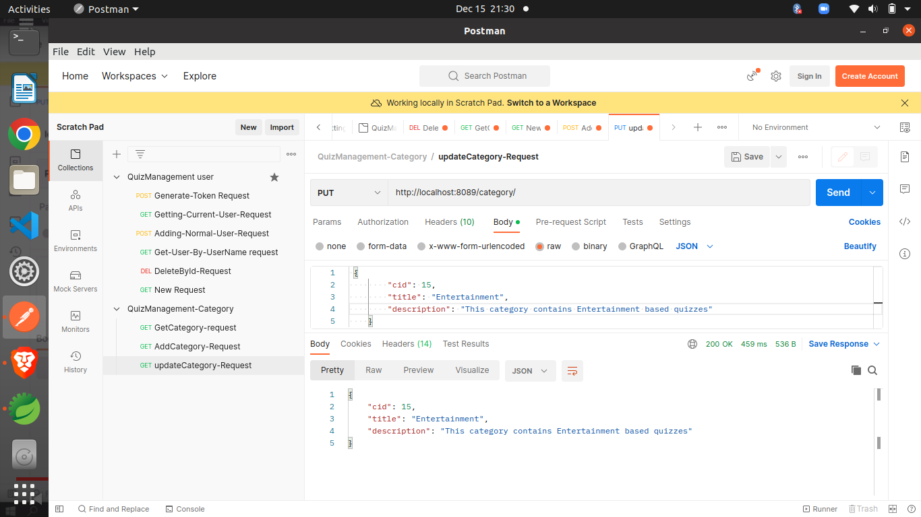

Slide 22
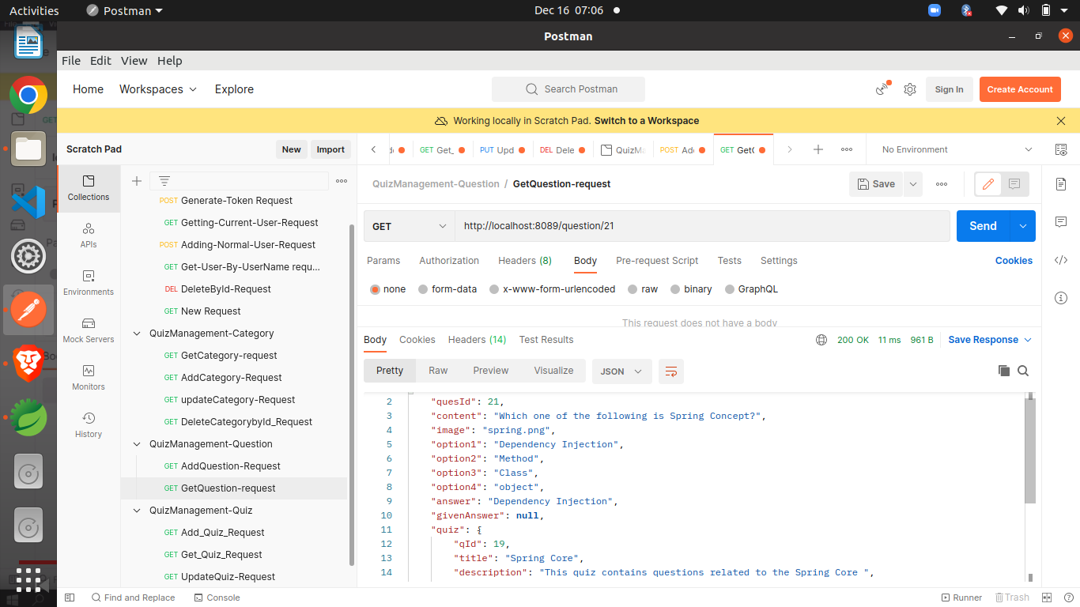

Slide 23
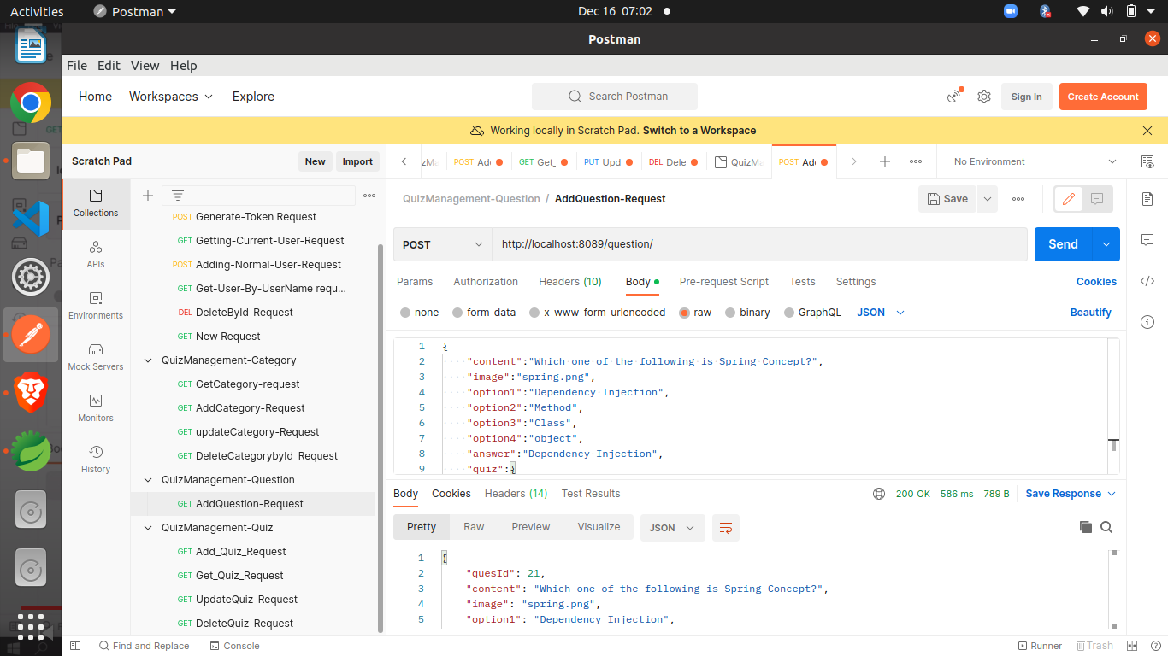

Slide 24
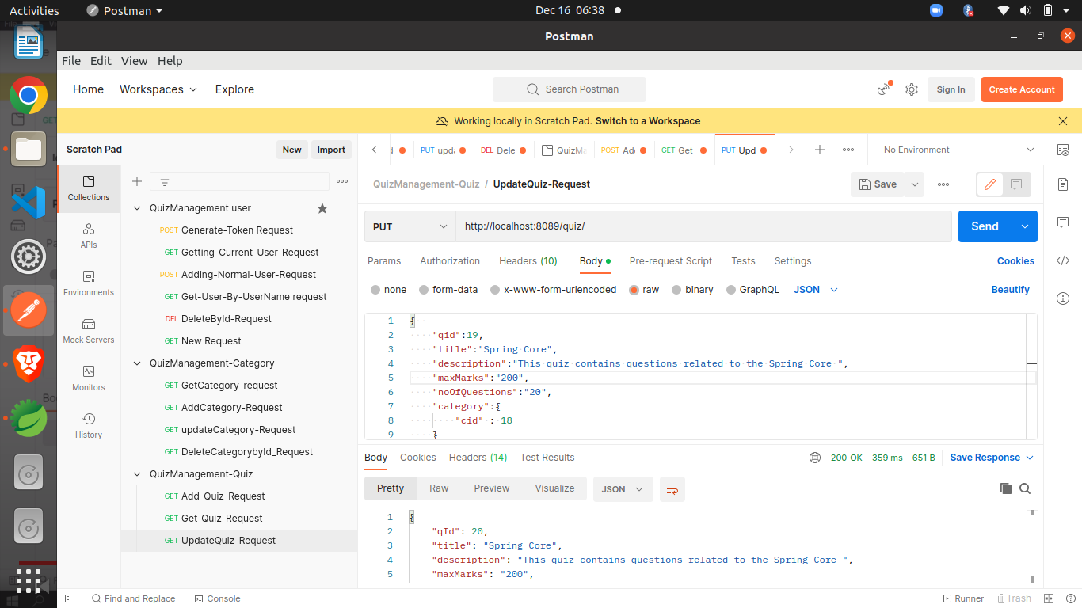

Slide 25
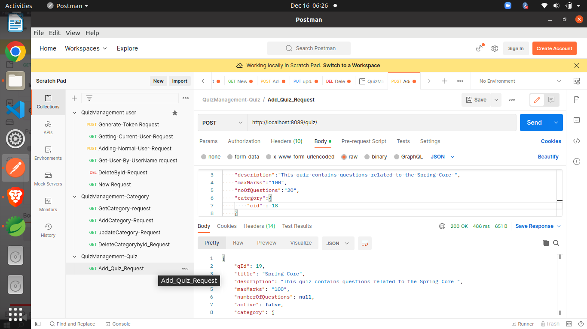

Slide 26
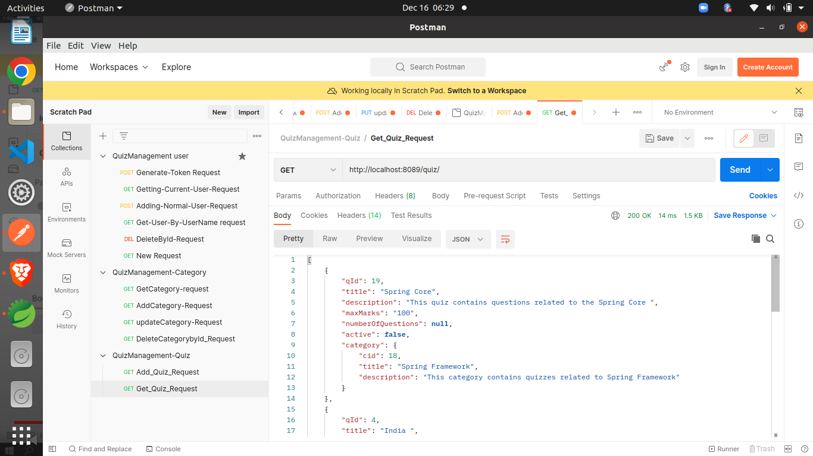

Slide 27
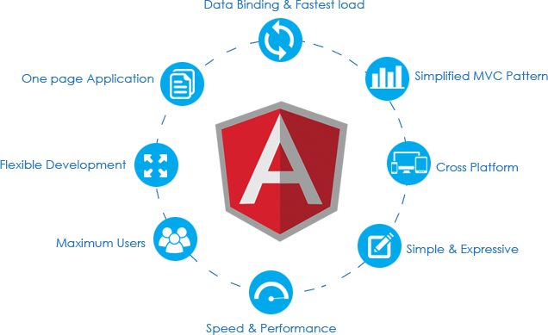
Angular
(Front-End)
Angular is a platform and framework for building single-page client applications using HTML and TypeScript. Angular is written in TypeScript. It implements core and optional functionality as a set of TypeScript libraries that you import into your applications.

Slide 28
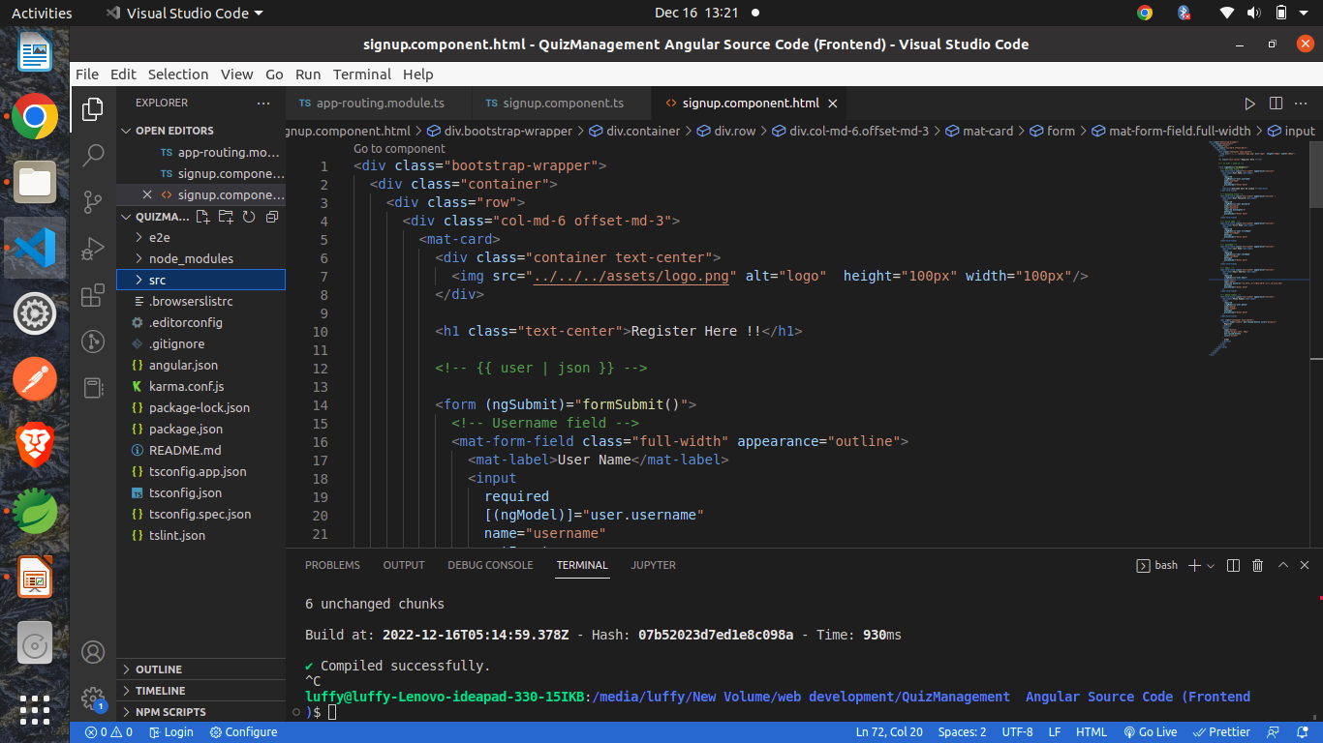
Angular Project Snap

Slide 29

Route Guards?
Angular route guards are interfaces provided by Angular which, when implemented, allow us to control the accessibility of a route based on conditions provided in class implementation of that interface.

Slide 30
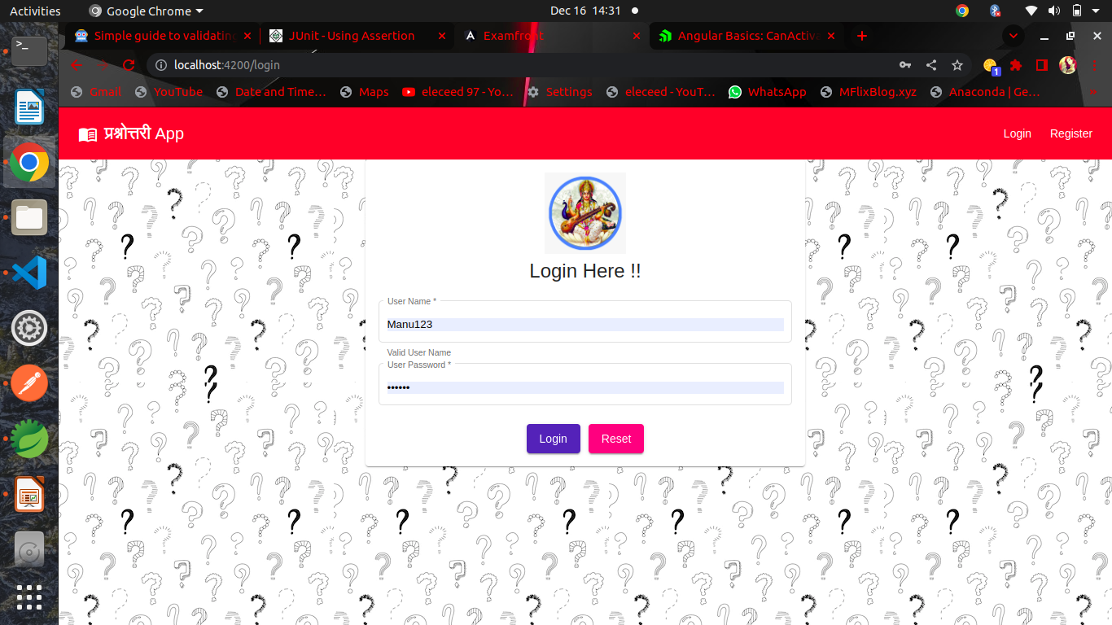
Working app snaps

Slide 31
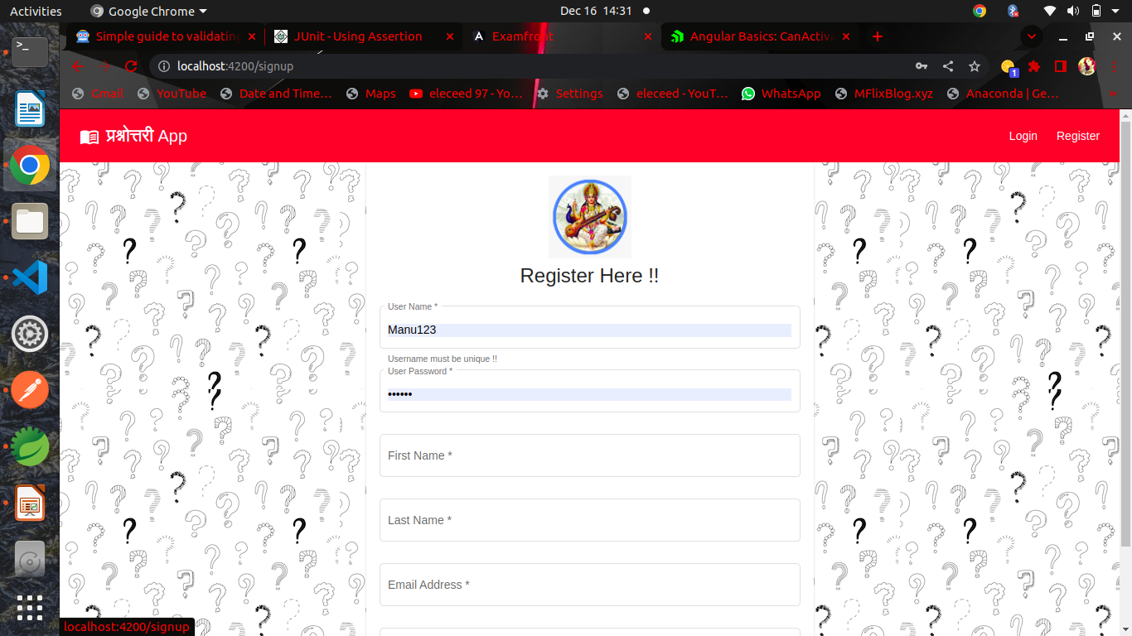

Slide 32
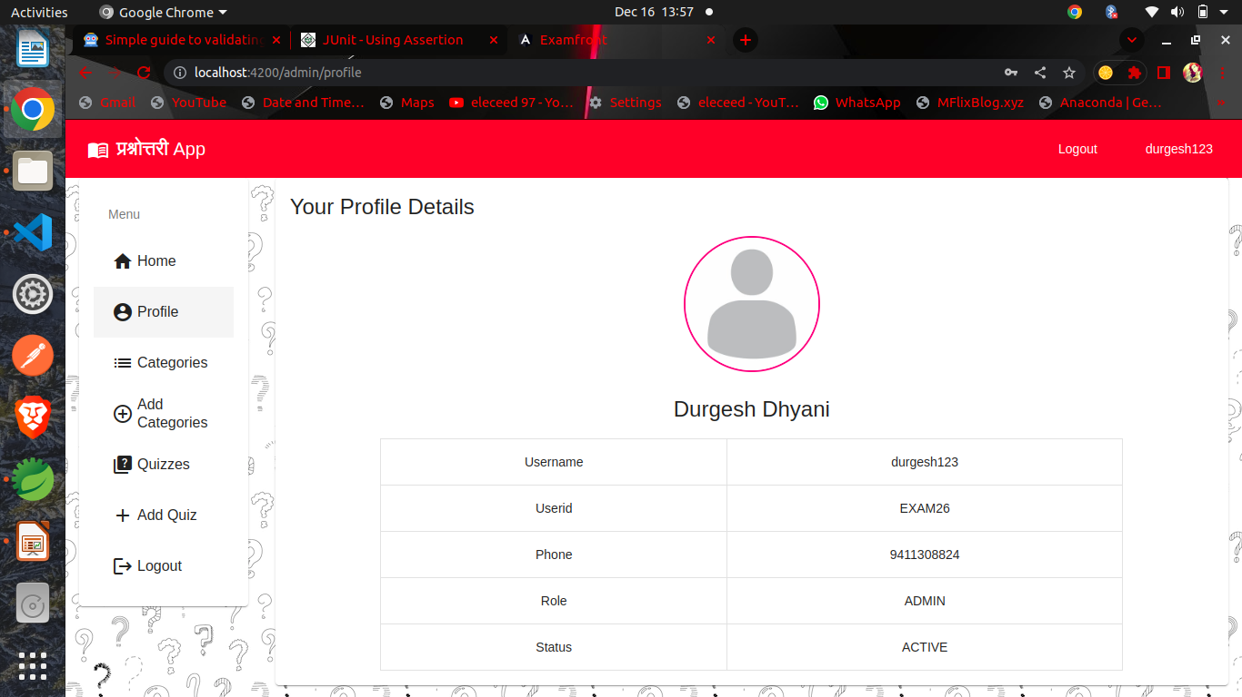

Slide 33
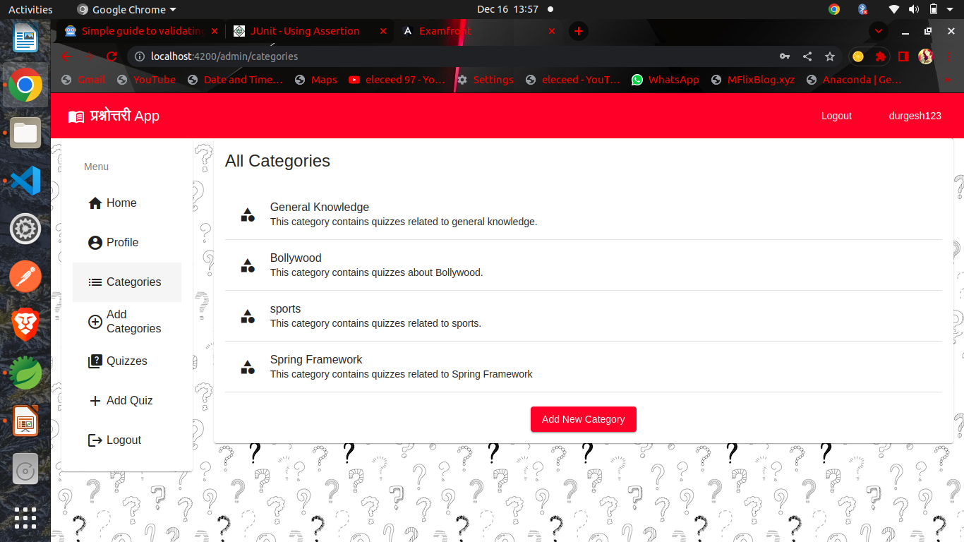

Slide 34
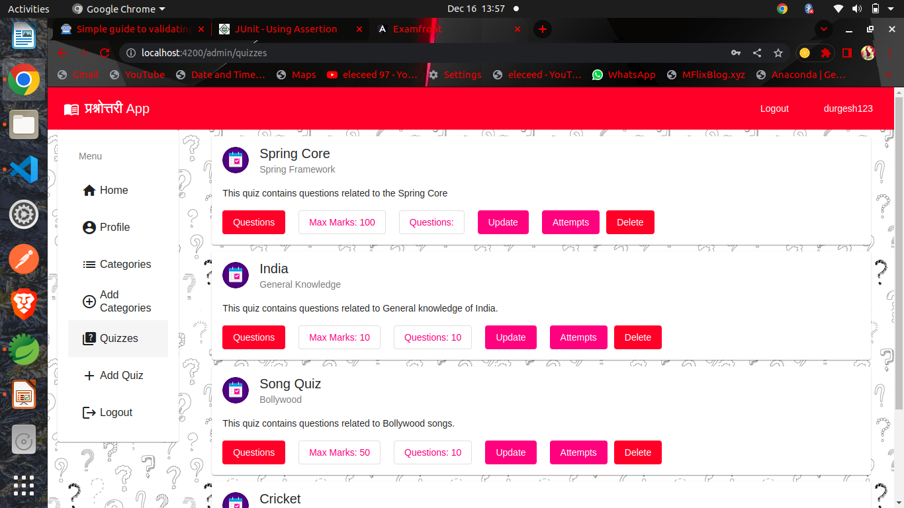

Slide 35
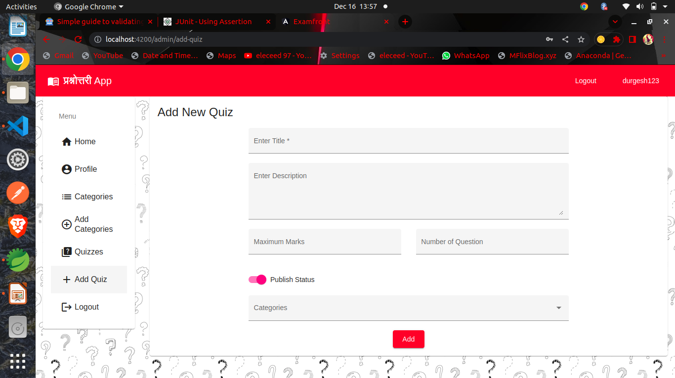

Slide 36
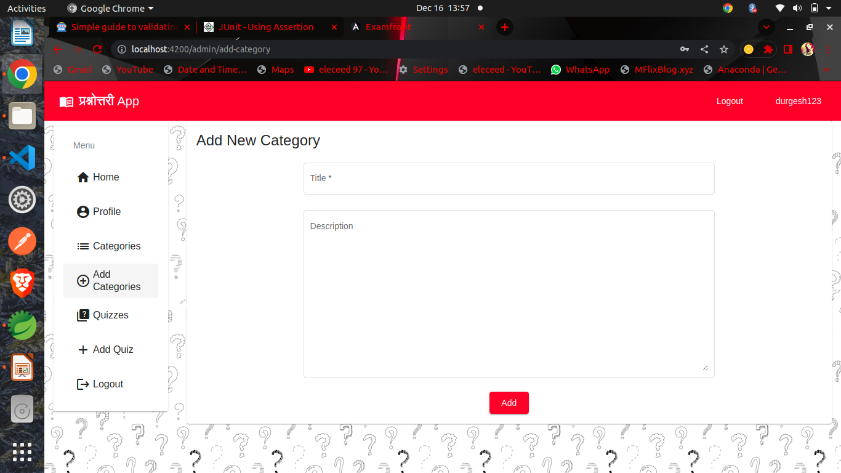

Slide 37
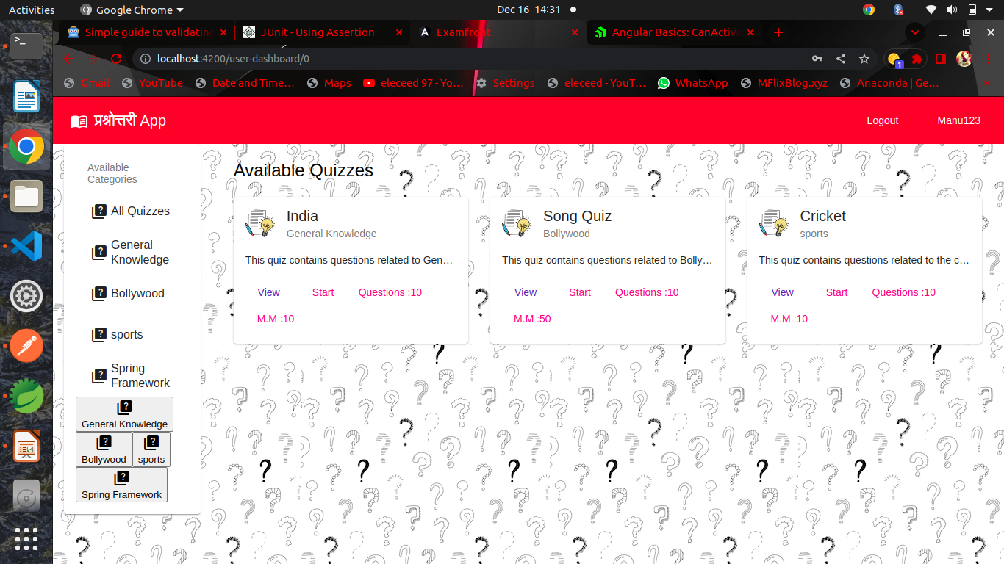

Slide 38
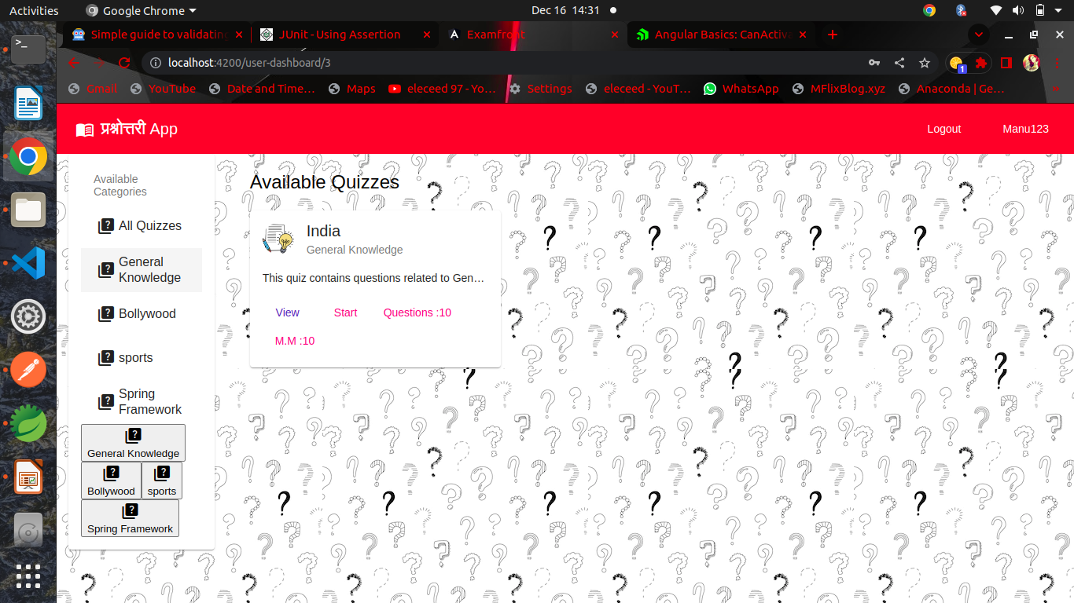

Slide 39
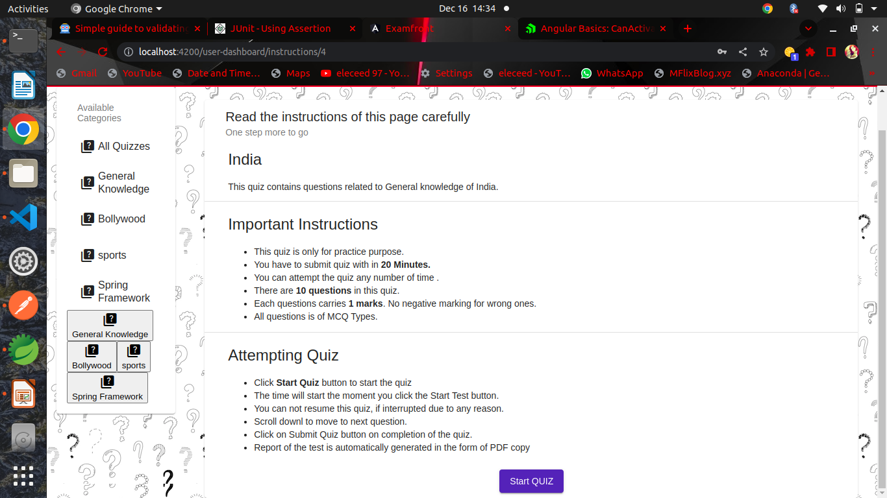

Slide 40
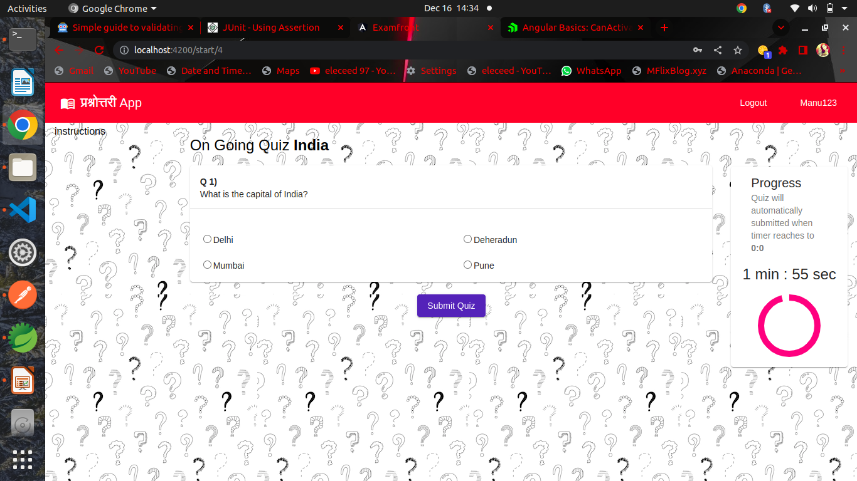

Slide 41
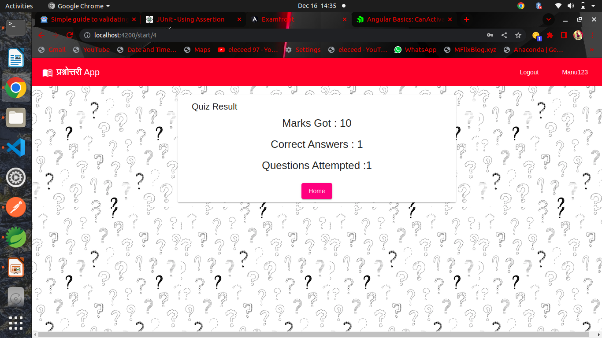

Slide 42
Future Scope
Adding descriptive type questions.
Better UI Experience for users(Students).
Descriptive solution oriented answer key for the better understanding of user.

Slide 43
Conclusion
This online quiz application provides facility to play quiz anywhere and anytime. It save time since user does need to wait for result. So student/user cannot wait for the result. All Student/ user get extra knowledge and skills. Administrator has a privilege to put as much as question in any category given in application. User can register, log-in, and give the test with his/her specific id, and can see the results as well.

Slide 44
References
https://stackoverflow.com/
https://www.javainuse.com/
https://angular.io/
https://material.angular.io/
https://sweetalert2.github.io/
https://tdev.app/ngx-ui-loader/demo/

Slide 45

Thanking Edubridge Team
Java (Domain)Tutor : Pavitra mam
Communication Tutor : Shweta mam

